Slide 1
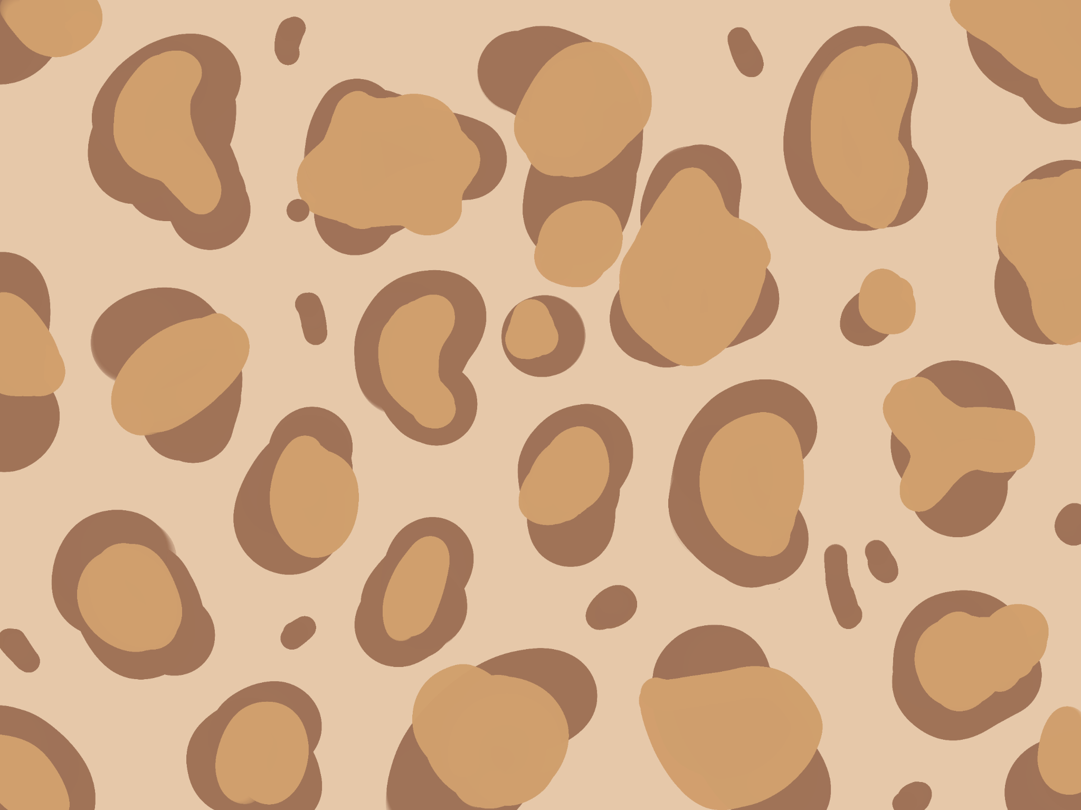
5 minutes per group:
overview (1 - 2 min) Jiangyue
what is the purpose?
what are the users?
what are the use cases?
what larger problem are you trying to solve?
which pieces of software did you use? how did you make use of them? (1 min)
what did you struggle with? (Guy)
Time complexity of generating all possible solutions
Sneaky math to make sure modifications to graphs were transitive and symmetric
what are the next steps?
Conda install
Problem statement or description (Jiangyue)
Human centered description of users or use cases
Technologies you used (Ziqi - streamlit)
Major challenges (Guy)
Next steps (Jiangyue)

Slide 2

LeOpard Link (LOL)
Courtney Allen, Ziqi Guo, Guy Bennevat Haninovich, Jiangyue Wang
Notes:
Good afternoon everyone, our group project is LeOpardLink, and we are … This project comes from my research project on leopards survey

Slide 3
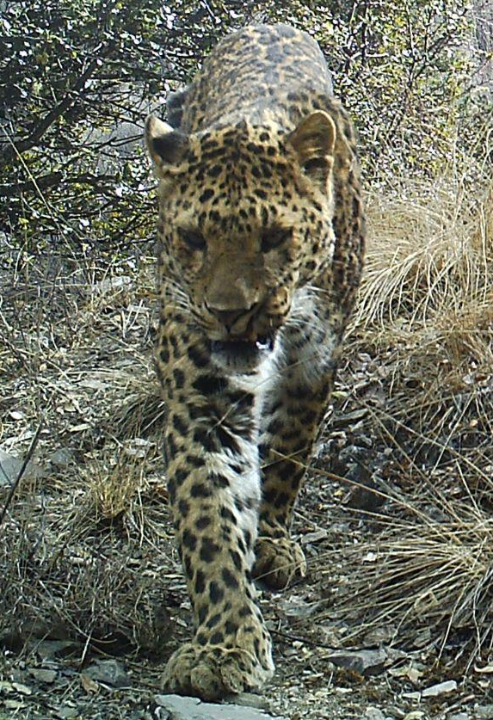
We are counting leopards through cameras set in the field
Population estimation in a study area (national park, administrative units) for management and conservation
Track movements
Understand behavioral patterns
Notes:
Through the cameras we set in the field, we get images of leopards and we want to know the No. leopards in our study area for better management and conservation of local population. Also, identifying the same individual in different locations could let us track their movements. We can also derive some special behaviors from the images.

Slide 4
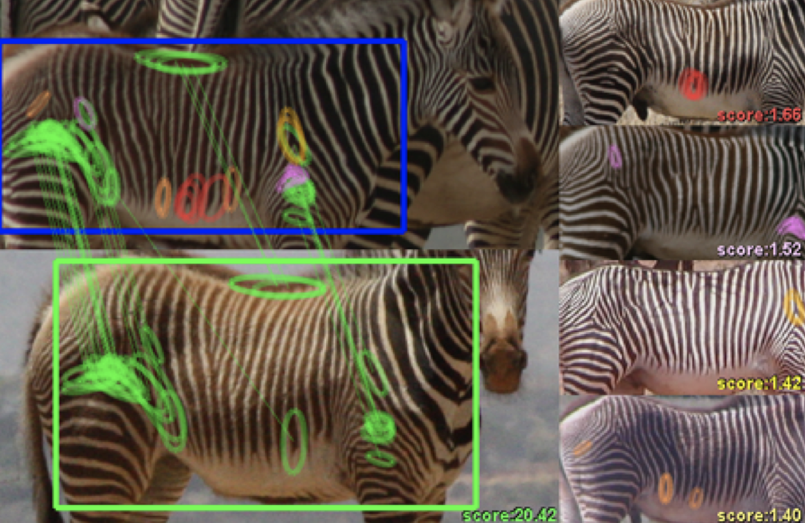
What’s wrong with current counting practices?
Manually identify - identify images one by one, then put into:
Folder 1, Folder 2,....
Computer vision
Score based on similarity
How to deal with uncertainties?
http://cs.rpi.edu/hotspotter/crall-hotspotter-wacv-2013.pdf
Notes:
There are mainly two ways to identify individuals currently. One is manual identifications, we create folders to represent individuals and put images into the folder. Another is through computer vision, and we will get scores based on the similarity of images. But there is one core problem of these approaches: how do we deal with uncertainties? For manual approach, if I do not know which individual does this image belong to, where should I put it? For cv approach, a score of 90 indicates same, score below 10 is absolutely different inds, but how about score in between? Simply delete it will cause us losing a lot of precious information. Tht’s why we developed this Leopardlink to reserve all uncertainties and get a complete estimation set of population size.

Slide 5
Our design
Manually identify images one by one
Computer vision rank similarity scores
Users
Conservation practitioners
identify animals in a simple and accurate logic
Quantitative researchers incorporate computer vision into identification and want to keep all information
Government officials want to visualize the identification results
Pairwise comparison
Output: 1(same),0(diff),-1(uncertain)
 | Img1 | Img2
Img1 | 1 | 0
Img2 | 0 | 1
Notes:
We simplify the identification process to pairwise comparison, the decision will only be 1 for same individual, 0 for different, -1 for uncertain relationships, we then will have a comparison matrix like showing below as our input. Here Img1 and 2are different inds. Our users include…

Slide 6
Our design
Components
UI - streamlit: a web app accessing most functions easily - no local environment needed
Interactive visualization: Jaal for python package & Pyvis for UI
Algorithm to deal with uncertainties: generate all possible graphs based current graphs
Users
Conservation practitioners
identify animals in a simple and accurate logic
Quantitative researchers incorporate computer vision into identification and want to keep all information
Government officials want to visualize the identification results
Notes:
Based on our users, we developed corresponding components, the major 3 are :... And then we ‘ll have courtney and guy to introduce them

Slide 7
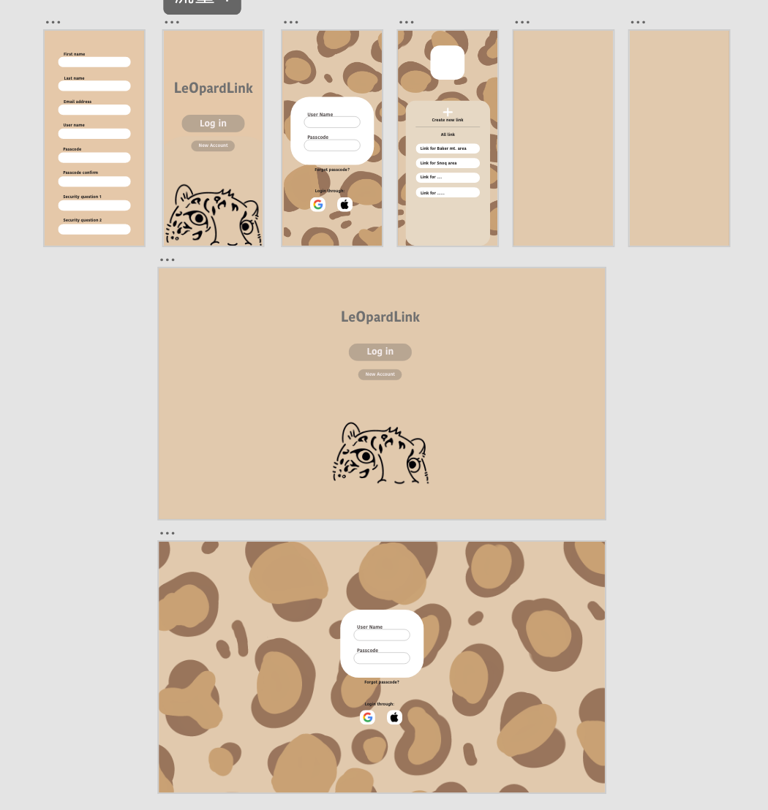
UI Design - From Xd to streamlit
https://leopardlink.streamlit.app/
Notes:
On the right is our design of LeOpardLink at adobe Xd and at the right are the link to our streamlit
Another key component for our project is a User Interface so that someone does not need to have knowledge of python in order to use what we’ve created.
We used Adobe XD to create a UI prototype, then implemented this design in Streamlit. This screen recording here, shows quickly shows a very simple three step process. 1) enter your name, 2) upload your matrix, a sample dataset is already uploaded and 3) click on generate matrix.
Now let me talk about the technology we use for the matrix/network visualizations.

Slide 8
Interactive visualization - PyVis
Python-based network visualization tool
Customizable, interactive, simple and is embedded in our UI
Allowed us to utilize existing technology for one of the most important components of our design
Notes:
We used an existing technology – the network visualization software tool, PyVis– to visualize the networks that will be uploaded by our users. This software can be embedded in our UI and is both customizable by us and interactive for the user. Because we were able to use this existing technology for on of the most important components of our project – the visualization – we were able to focus on other components and challenges.

Slide 9

Challenges
exponential growth
generate all possible combinations
Notes:
I’m going to talk about our main challenge in implementing this: time and storage complexity. There’s a lot to be said here in regards to data types, programming languages and so on but in the interest of time I’m keeping things relatively simple.

Slide 10
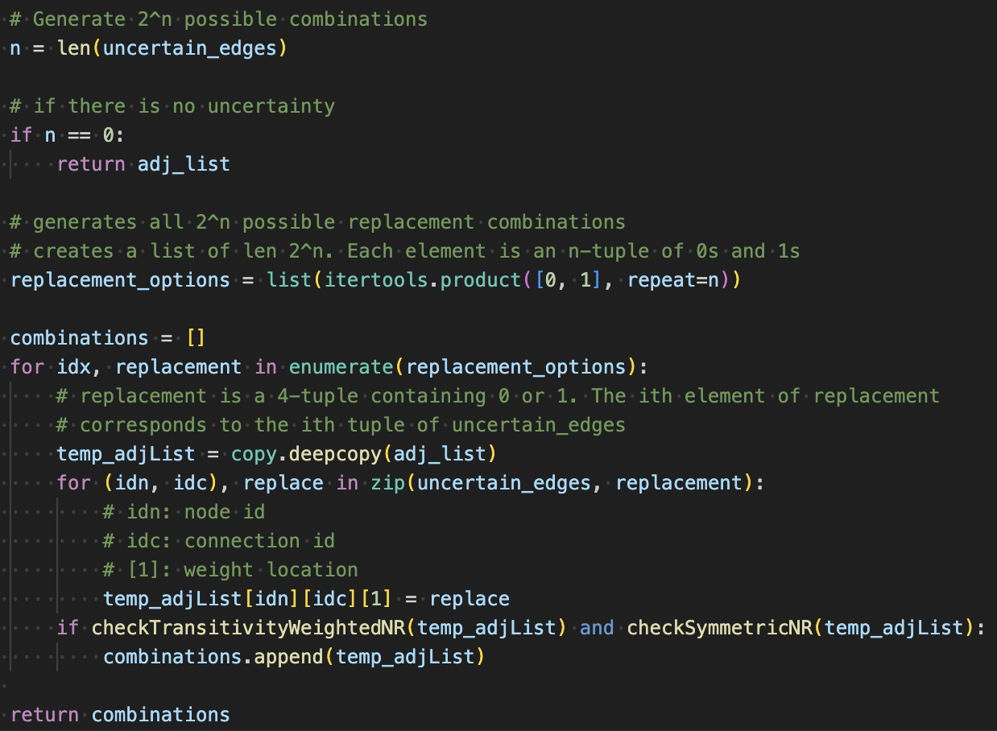
Naive approach
Generate all possible replacement combinations
Create 2^{n} deep copies of the original matrix
Iteratively replace uncertain edges
Evaluate the results for transitivity and symmetry
Notes:
This was our first approach. Just to get something that worked and to make sure our other functions were also working as intended. This is the naive / brute force approach

Slide 11
Solutions
exponential growth
✨recursion✨
(and pruning)
generate all possible combinations

Slide 12
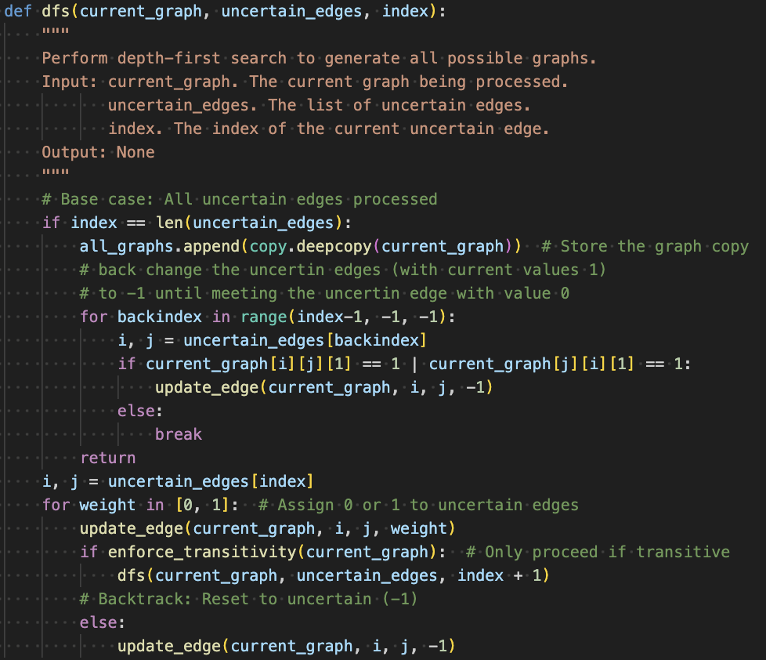
Recursive approach
Utilize recursive calls to manage space complexity
Evaluate replacement instructions as they are generated.
Prune replacement instructions that will return non-transitive results

Slide 13

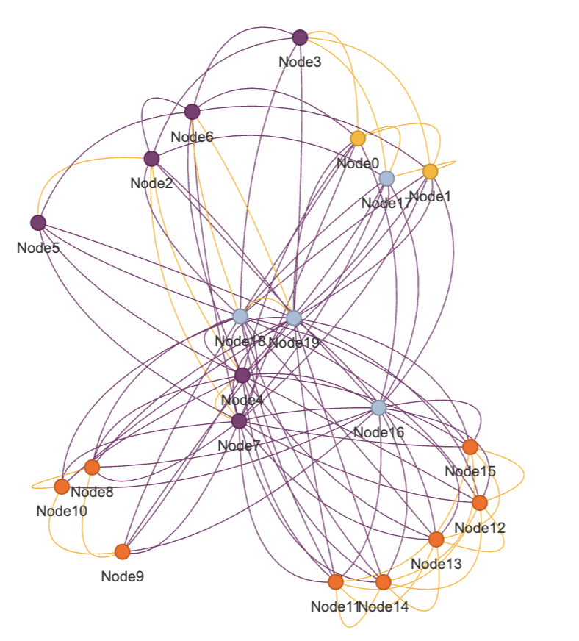
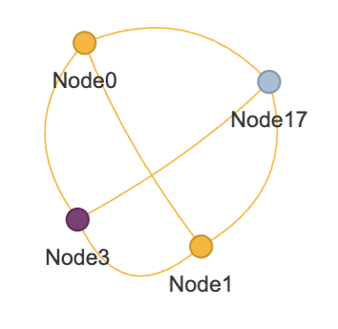
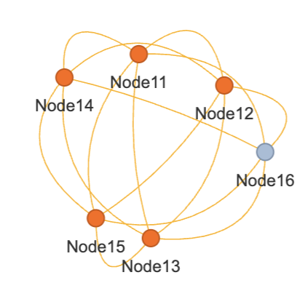
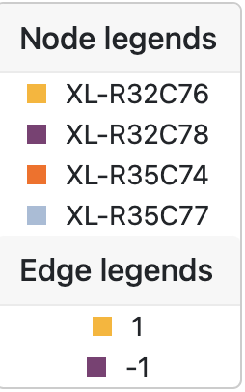
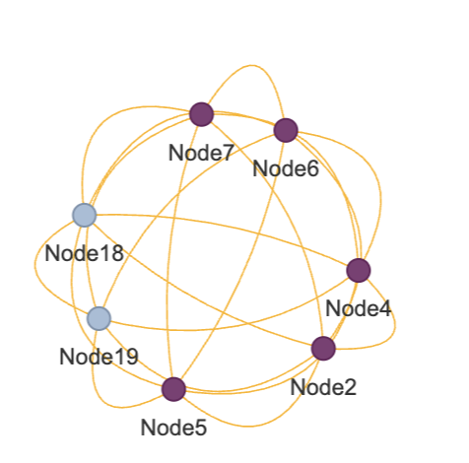
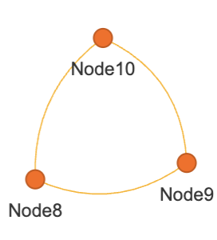
Recursive approach
(one possible output)
Notes:
And I couldn’t even run the naive approach because my computer ran out of ram ;D

Slide 14
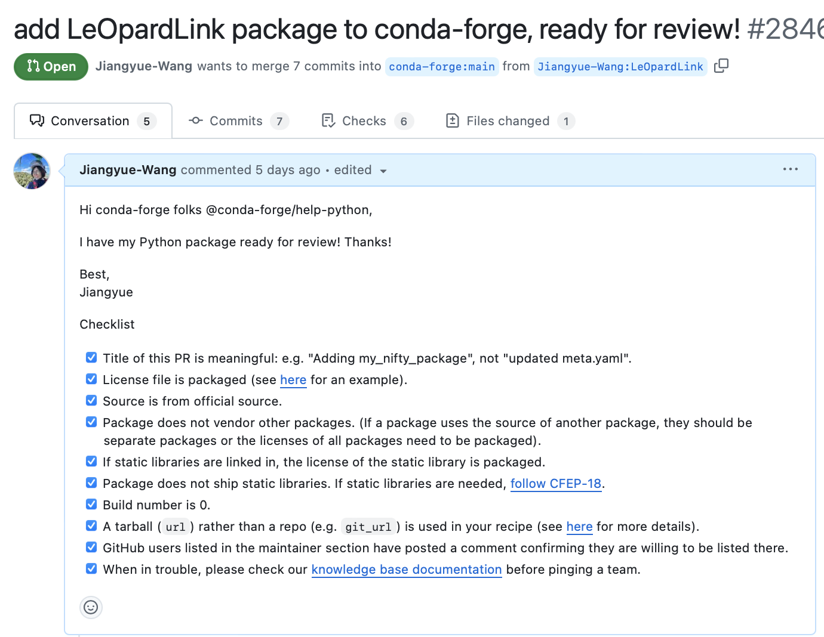
Next steps
Waiting for admin review for pull requests to conda-forge
Incorporate more flexibility in web app visualization - color by node features
(Long-term goal) Connect with computer vision apps - convert scores to certain/uncertain edges
Notes:
So we get a functional web app now, it’s also installable by pip install. Our plans for next steps are, first make it installable from conda and we are waiting … Second we…Third is our long term goal, to connect our app with cv apps to get a fully automatic animal identification pipeline.

Slide 15
Thank you and let’s link the leopards!
https://leopardlink.streamlit.app/
© 2024 Team LeOpardLink. All rights reserved. CSE583 - Autumn 2024, University of Washington
Notes:
Thank you all for attention, and come to try our web app to link the leopards!

